Slide 1

ECE 1710: Power Distribution Engineering and Smart Grids
Lecture 13
Dr. Robert Kerestes
University of Pittsburgh
Swanson School of Engineering
Department of Electrical and Computer Engineering
Notes:
Instructions for editing school and department titles:
Select from menu: View > Master > Slide Master
Click on each text area you wish to edit. Text will become editable.

Slide 2
Outline
Outline of Lecture No. 13
Module #1: Introduction to Step-Voltage Regulators
Module #2: Type A and Type B Single-Phase Voltage Regulators
Module #3: Line Drop Compensators
Module #4: Line Drop Compensator Example

Slide 3
Learning Objectives
Learning Objectives:
Describe the components and settings of the step-voltage regulator control circuit
State the difference between Type A and Type B voltage regulators and identify them by their equivalent and abbreviated circuits
Apply the voltage and current equations for the Type B voltage regulator
Calculate the a, b, c, d, A and B for the Type B voltage regulator and use them to solve for system voltages and currents
Determine PT & CT ratings and R & X settings for load drop compensator circuits and calculate equivalent line impedances

Slide 4
Introduction to Step-Voltage Regulators
Module #1

Slide 5
Introduction to Step-Voltage Regulators
Module #1
A step-voltage regulator consists of an autotransformer and a LTC mechanism.
The voltage change is obtained by changing the taps of the series winding of the autotransformer. The position of the tap is determined by a control circuit i.e. line drop compensator.
Standard step-regulators contain a reversing switch enabling a ±10% regulator range, usually in 32 steps. This amounts to a 5/8% change per step or 0.75 V change per step on a 120 V base.

Slide 6
Introduction to Step-Voltage Regulators
Module #1

Slide 7
Introduction to Step-Voltage Regulators
Module #1
ANSI/IEEE C57.15 defines two circuit configurations for step-regulators
“Type A” or the “straight regulator”
“Type B” or the “inverted regulator”

Slide 8
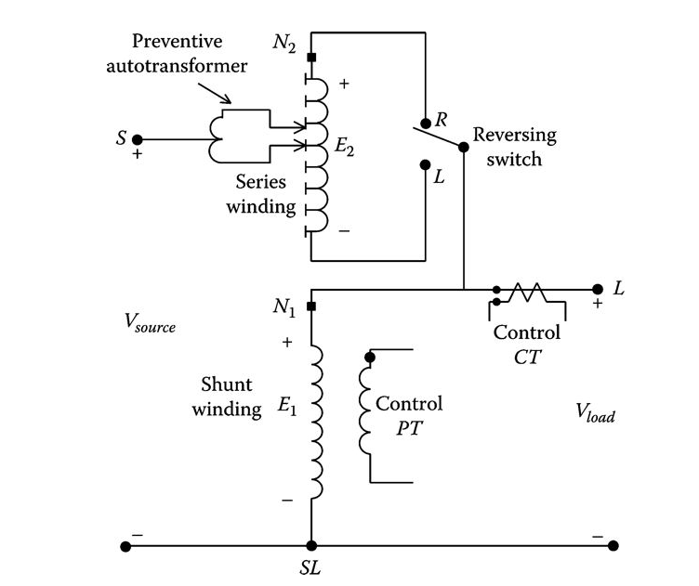
Introduction to Step-Voltage Regulators
Module #1
Type B regulator”

Slide 9
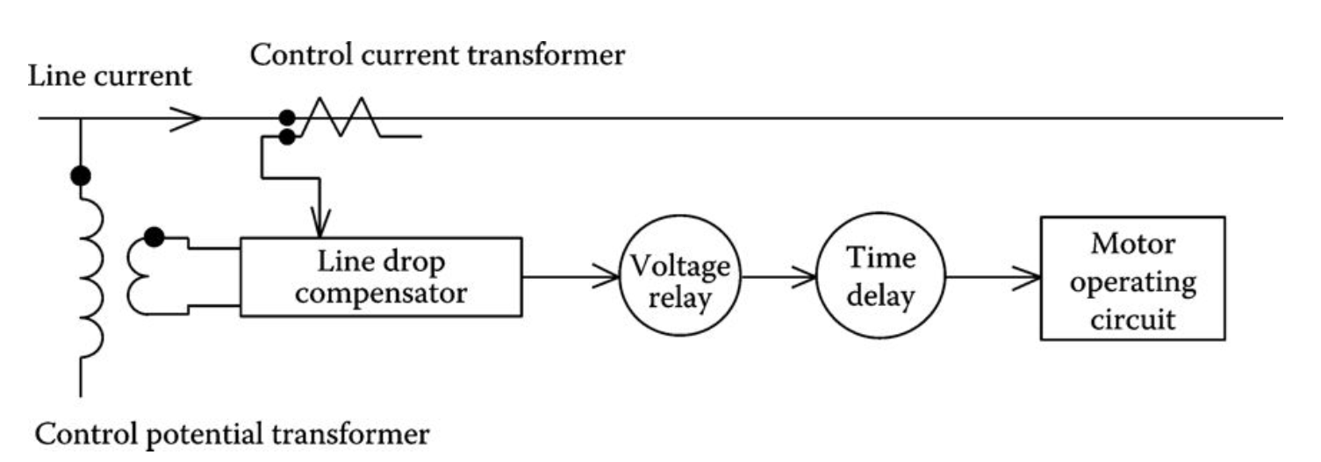
Introduction to Step-Voltage Regulators
Module #1
The control block diagram for a voltage regulator is shown in the figure below:

Slide 10
Introduction to Step-Voltage Regulators
Module #1
The step-voltage regulator control circuit requires the following settings:
Voltage level: The desired voltage (on 120 V base) to be held at the “load center.” The load center may be the output terminal of the regulator or a remote node on the feeder.
Bandwidth: The allowed variance of the load center voltage from the set voltage level. The voltage held at the load center will be ±1/2 of the bandwidth. For example, if the voltage level is set to 122 V and the bandwidth set to 2 V, the regulator will change taps until the load center voltage lies between 121 and 123 V.
Time delay: Length of time that a raise or lower operation is called for before the actual execution of the command. This prevents taps changing during a transient or short time change in current.
Line drop compensator: Set to compensate for the voltage drop (line drop) between the regulator and the load center.

Slide 11
Introduction to Step-Voltage Regulators
Module #1
More on line drop compensator
Analog compensator: Analog circuit set to compensate for the voltage drop (line drop) between the regulator and the load center. The settings consist of R and X settings in volts corresponding to the equivalent impedance between the regulator and the “load center.” This setting may be zero if the regulator output terminals are the “load center.”
Digital compensator: The same as the analog compensator; only the output voltage of the compensator is computed similar to a computer program. Based upon the computed output, compensator voltage taps will change in order to hold the “load-center” voltage within specified limits.
Smart meters: With the advent of the “smart grid,” it is possible for the actual voltage at the “load center” to be transmitted back to the regulator. Taps are then changed to hold the “load-center” voltage within the prescribed limits.

Slide 12
Introduction to Step-Voltage Regulators
Module #1
The required rating of a step-regulator is based upon the kVA transformed and not the kVA rating of the line.
In general, this will be 10% of the line rating since rated current flows through the series winding, which represents the ±10% voltage change.
The kVA rating of the step-voltage regulator is determined in the same manner as that of the previously discussed autotransformer.

Slide 13
Introduction to Step-Voltage Regulators
Module #1
Question: (True or False) A step-regulator is rated on the kVA of the line it is connected to.

Slide 14
Introduction to Step-Voltage Regulators
Module #1
Question: If a voltage-regulator is set to keep voltage at 121.5 volts on a 120 volt base and has a bandwidth of 3 volts, the voltage-regulator will keep the voltage in between
118.5 and 124.5 volts
119.5 and 123.5 volts
120 and 123 volts
118.5 and 121.5 vols

Slide 15
Module #2
Type A and B Single-Phase Voltage Regulators

Slide 16
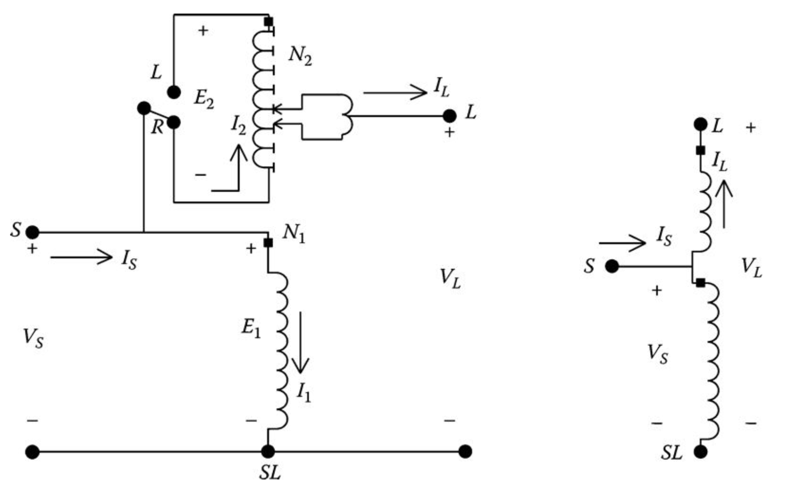
Type A and Type B Single Phase Voltage Regulators
Module #2
The detailed equivalent circuit and abbreviated equivalent circuit of a Type A step-voltage regulator in the “raise” position are shown below:

Slide 17
Type A and Type B Single Phase Voltage Regulators
Module #2
As shown on the previous slide, the primary circuit of the system is connected directly to the shunt winding of the Type A regulator.
The series winding is connected to the shunt winding and, in turn, via taps, to the regulated circuit.
In this connection, the core excitation varies because the shunt winding is connected directly across primary circuit.
When the Type A connection is in the “lower” position, the reversing switch is connected to the “L” terminal. The effect of this reversal is to reverse the direction of the currents in the series and shunt windings.

Slide 18
Type A and Type B Single Phase Voltage Regulators
Module #2
The more common connection for step-voltage regulators is the Type B. Since this is the more common connection, the defining voltage and current equations for the voltage regulator will be developed only for the Type B connection.

Slide 19
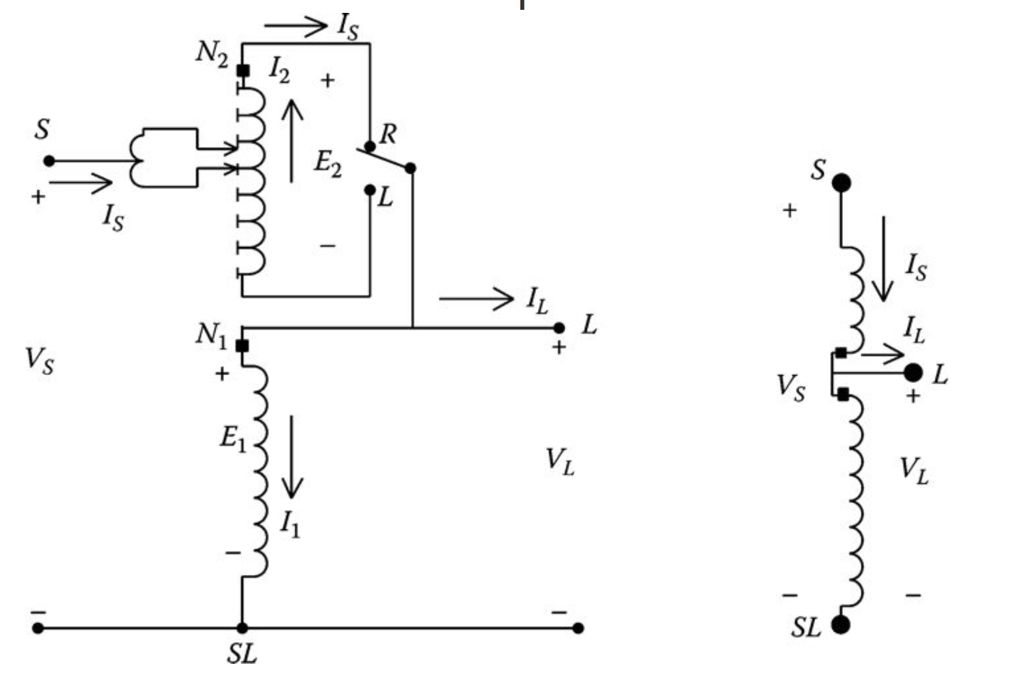
Type A and Type B Single Phase Voltage Regulators
Module #2
The detailed equivalent circuit and abbreviated equivalent circuit of a Type B step-voltage regulator in the “raise” (R) position are shown below:

Slide 20
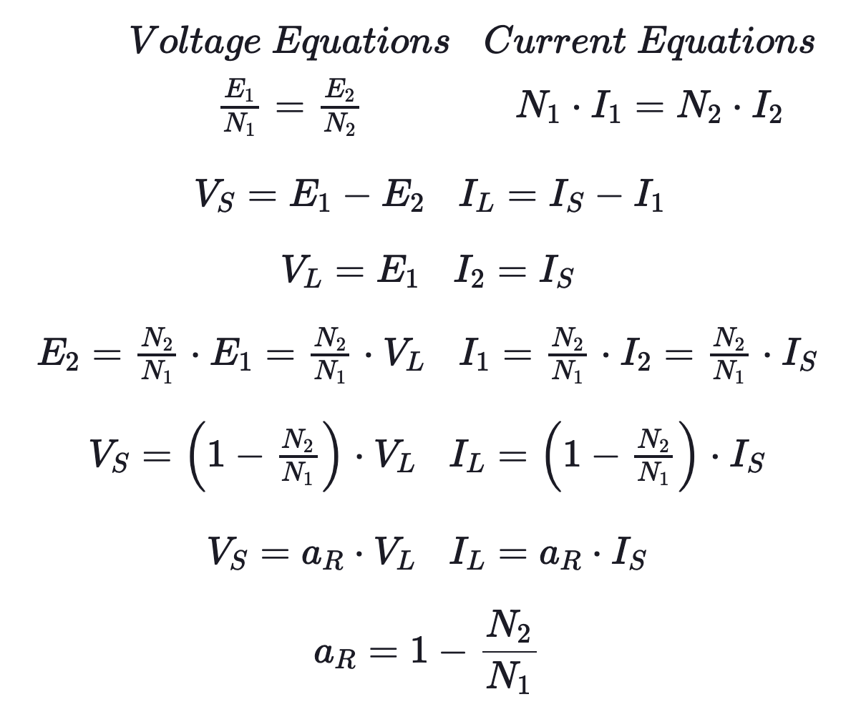
Type A and Type B Single Phase Voltage Regulators
Module #2
Defining the voltage and current equations for the regulator in the raise position are:

Slide 21
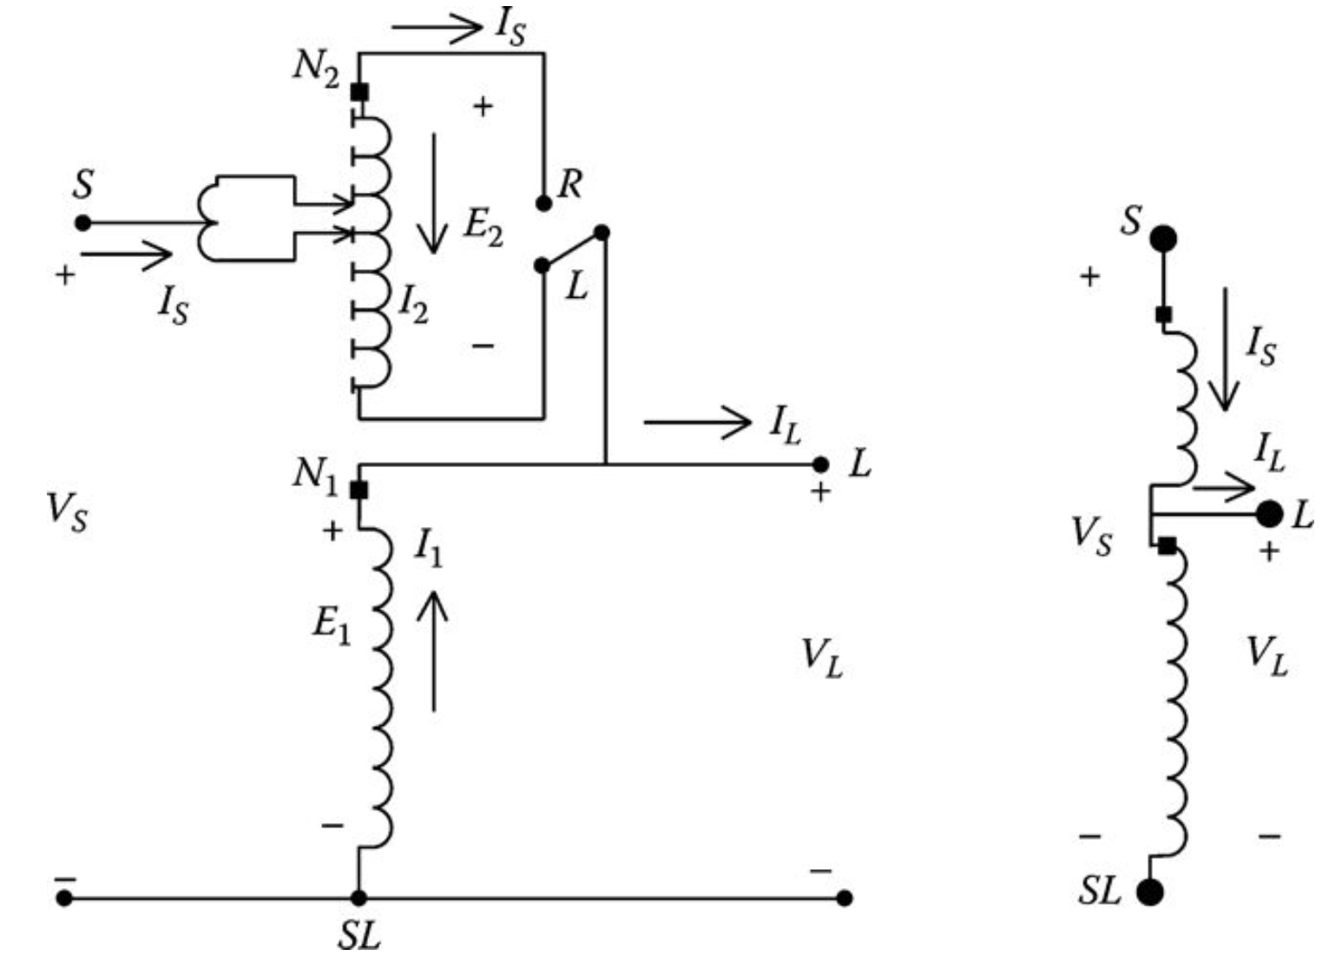
Type A and Type B Single Phase Voltage Regulators
Module #2
The detailed equivalent circuit and abbreviated equivalent circuit of a Type B step-voltage regulator in the “lower” (L) position are shown below:

Slide 22
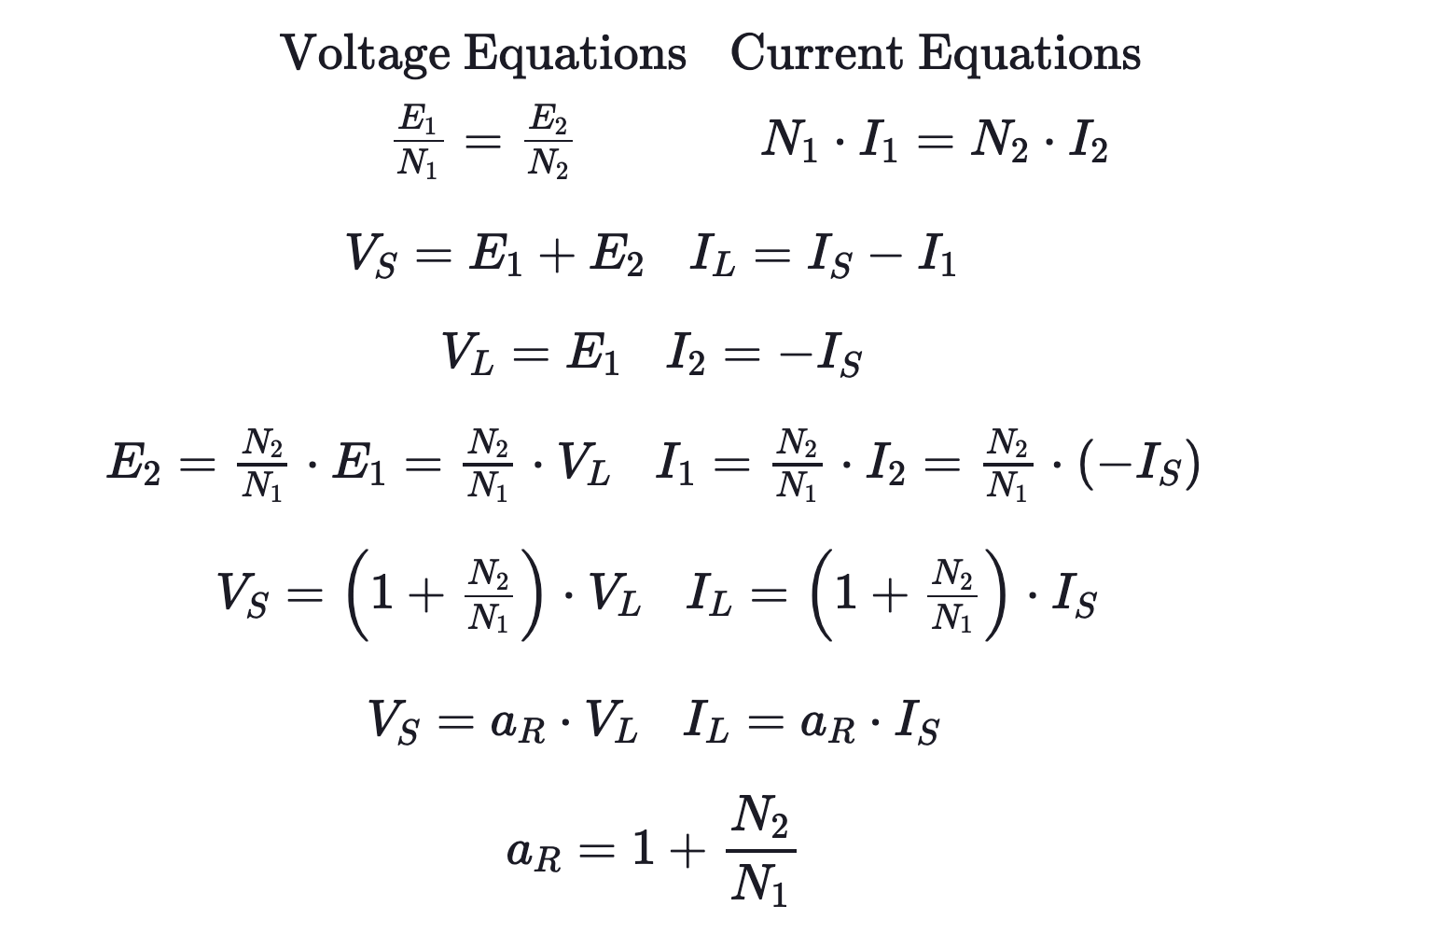
Type A and Type B Single Phase Voltage Regulators
Module #2
Defining the voltage and current equations for the regulator in the lower position are:

Slide 23

Type A and Type B Single Phase Voltage Regulators
Module #2
The turns ratio can be defined for the raise position or lower position as a function of the tap setting as:
Where we have a – (minus) for the raise position and a + (plus) for the lower position

Slide 24
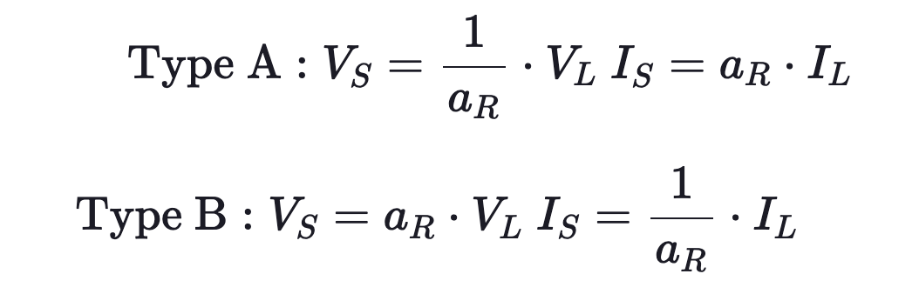
Type A and Type B Single Phase Voltage Regulators
Module #2
For both Type A and Type B regulators, the relationship between the source voltage and current to the load voltage and current is of the form:

Slide 25
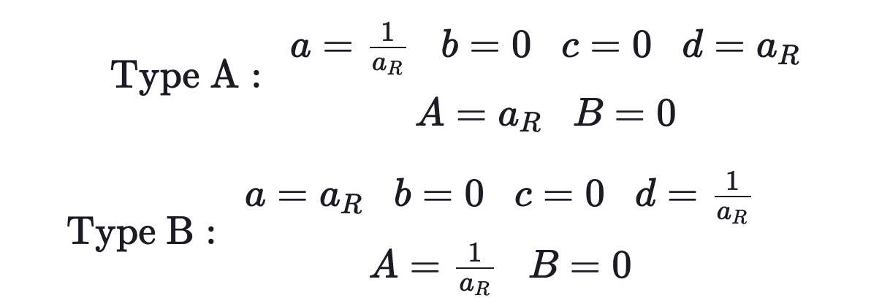
Type A and Type B Single Phase Voltage Regulators
Module #2
Therefore, the generalized constants for a single-phase step-voltage regulator become

Slide 26
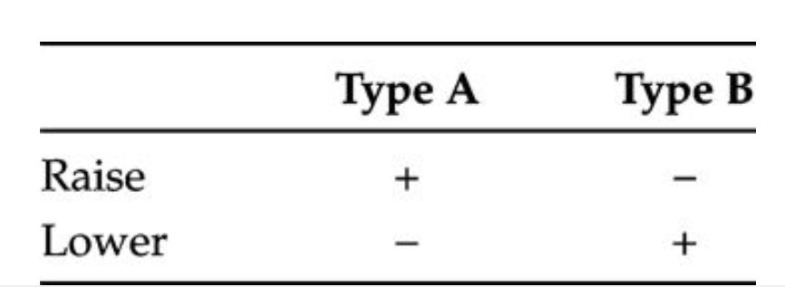
Type A and Type B Single Phase Voltage Regulators
Module #2
Sign convention table for a_{r}

Slide 27
Type A and Type B Single Phase Voltage Regulators
Module #2
Question: For a type B voltage regulator, if the autotransformer is in the lower position, then the source voltage will be ______________ than the load voltage
greater
less

Slide 28
Type A and Type B Single Phase Voltage Regulators
Module #2
Question: (True of False) Type A regulators are much more common than Type B regulators.

Slide 29
Module #3
Line Drop Compensator

Slide 30
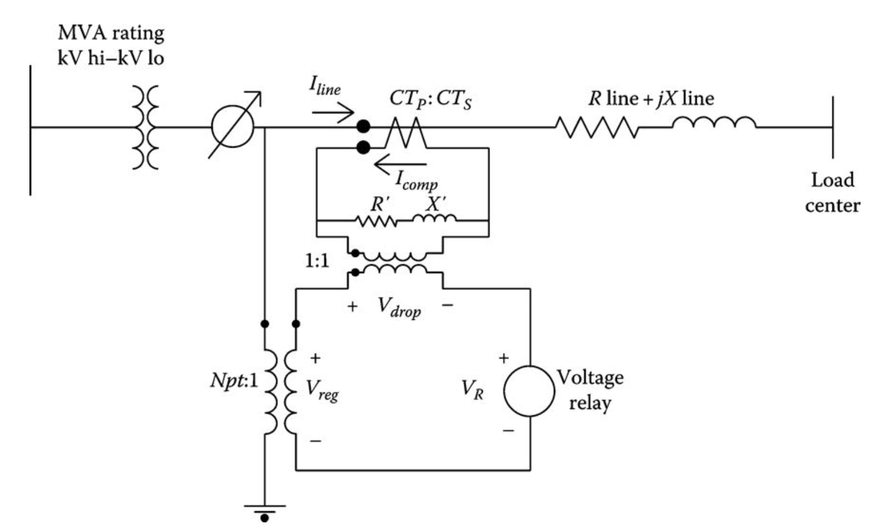
Line Drop Compensators
Module #3
The changing of taps on a regulator is controlled by the line drop compensator

Slide 31
Line Drop Compensators
Module #3
Older regulators are controlled by an analog compensator circuit. Modern regulators are controlled by a digital compensator.
The digital compensators require the same settings as the analog, because it is easy to visualize, the analog circuit will be used in this section. However, understand that the modern digital compensators perform the same function for changing the taps on the regulators.

Slide 32
Line Drop Compensators
Module #3
Note: As the smart grid becomes popular, it will be possible to transmit the load-center voltage directly to the regulator, so there will not be a need for the compensator circuit

Slide 33
Line Drop Compensators
Module #3
The purpose of the line drop compensator is to model the voltage drop of the distribution line from the regulator to the “load center.”
The compensator is an analog circuit that is a scale model of the line circuit. The compensator input voltage is typically 120 V, which requires the potential transformer in figure shown on previously to reduce the rated voltage down to 120 V.
For a regulator connected line to ground, the rated voltage is the nominal line-to-neutral voltage, while for a regulator connected line to line, the rated voltage is the line-to-line voltage.

Slide 34
Line Drop Compensators
Module #3
The current transformer turns ratio is specified as CT_{P}: CT_{S} where the primary rating (CT_{P}) will typically be the rated current of the feeder.

Slide 35
Line Drop Compensators
Module #3
The setting that is most critical is that of R′ and X′ calibrated in volts. These values must represent the equivalent impedance from the regulator to the load center.
The basic requirement is to force the per-unit line impedance to be equal to the per-unit compensator impedance.
In order to cause this to happen, it is essential that a consistent set of base values be developed wherein the per-unit voltage and currents in the line and in the compensator are equal.

Slide 36
Line Drop Compensators
Module #3
The consistent set of base values is determined by selecting a base voltage and current for the line circuit and then computing the base voltage and current in the compensator by dividing the system base values by the potential transformer ratio and current transformer ratio, respectively.
For regulators connected line to ground, the base system voltage is selected as the rated line-to-neutral voltage (V_{LN}), and the base system current is selected as the rating of the primary winding of the current transformer (C_{TP}).

Slide 37
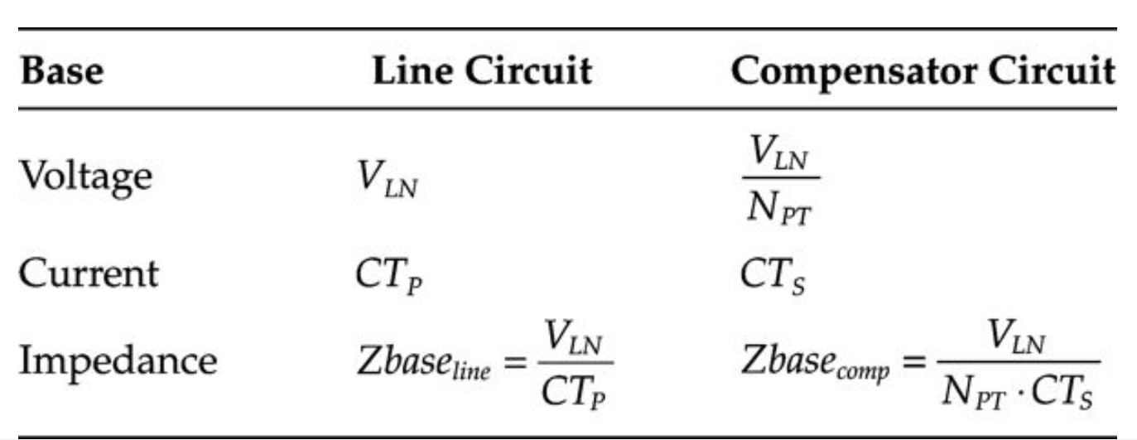
Line Drop Compensators
Module #3
The table shown below gives “table of base values” and employs these rules for a regulator connected line to ground:

Slide 38
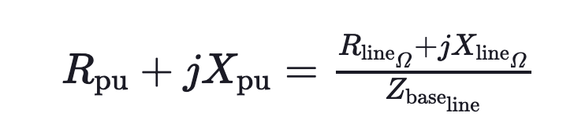

Line Drop Compensators
Module #3
With the table of base values developed, the compensator R and X settings in Ohms can be computed by first computing the per-unit line impedance:

Slide 39

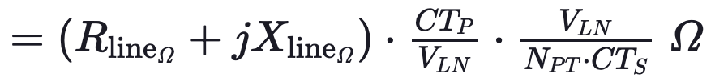
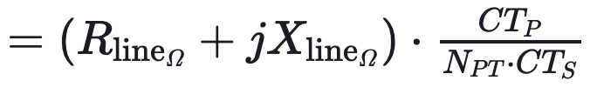

Line Drop Compensators
Module #3
The per-unit impedance of must be the same in the line and in the compensator. The compensator impedance in Ohms is computed by multiplying the per-unit impedance by the base compensator impedance:

Slide 40

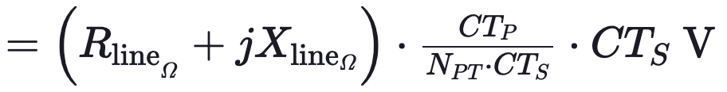
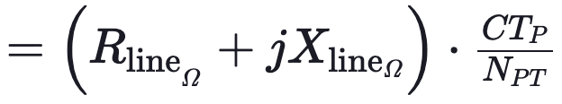

Line Drop Compensators
Module #3
This equation gives the value of the compensator R and X settings in Ohms. The compensator R and X settings in volts are determined by multiplying the compensator R and X in Ohms times the rated secondary current (CT_{S}) of the current transformer:

Slide 41
Line Drop Compensators
Module #3
It is important to understand that the value of equivalent line impedance is not the actual impedance of the line between the regulator and the load center.
Typically, the load center is located down the primary main feeder after several laterals have been tapped.
As a result, the current measured by the CT of the regulator is not the current that flows all the way from the regulator to the load center.
The only way to determine the equivalent line impedance value is to run a power-flow program of the feeder without the regulator operating.

Slide 42
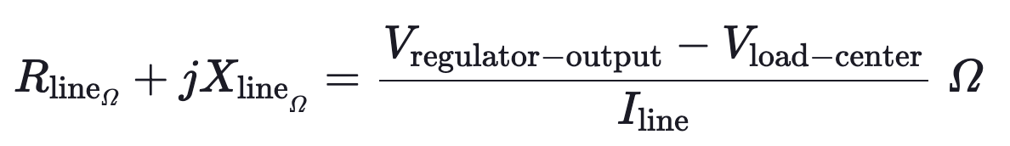
Line Drop Compensators
Module #3
From the output of the program, the voltages at the regulator output and the load center are known. Now the “equivalent” line impedance can be computed as:

Slide 43
Line Drop Compensators
Module #3
Question: The units for R’ and X’ in a line drop compensator are __________

Slide 44
Module #4
Line Drop Compensator Example

Slide 45
Module #4
Example: The substation transformer is rated 5000 kVA, 115 delta—4.16 grounded wye and the equivalent line impedance from the three single-phase regulators connected in wye to the load center is 0.3 + j0.9 Ω. The settings for each phase regulator will be the same. The compensator current should be rated at 5 amps.
Determine the potential transformer and current transformer ratings for the compensator circuit.
Determine the R and X settings of the compensator in ohms and volts.

Slide 46


Line Drop Compensator Example
Module #4
1. Determine the potential transformer and current transformer ratings for the compensator circuit.
The rated line-to-ground voltage of each regulator is:
In order to provide 120 V to the compensator, the potential transformer ratio is:

Slide 47
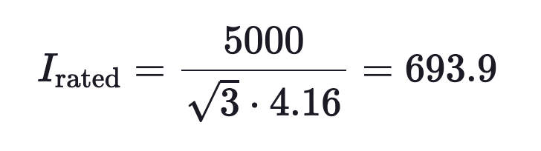
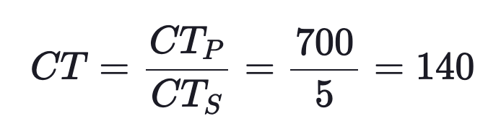
Line Drop Compensator Example
Module #4
The rated current of the substation transformer is:
The primary rating of the CT is selected as 700 amps, and if the compensator current is reduced to 5 amps, the CT ratio is:

Slide 48
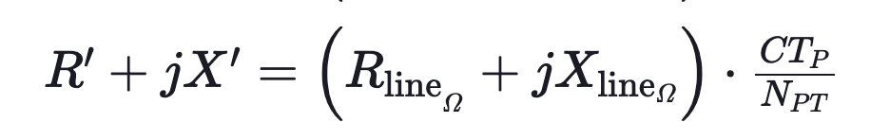
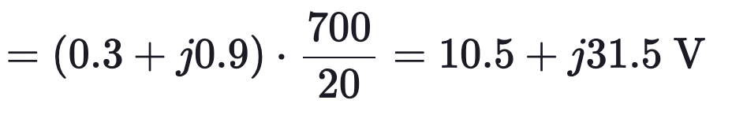
Line Drop Compensator Example
Module #4
2. Determine the R and X settings of the compensator in ohms and volts. To determine the settings in volts:

Slide 49
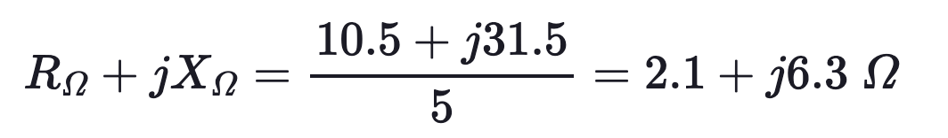
Line Drop Compensator Example
Module #4
The R and X settings in ohms are determined by dividing the settings in volts by the rated secondary current of the current transformer.
Understand that the R and X settings on the compensator control board are calibrated in volts.

